Slide 1
Magnetic Forces Fields & Faraday’s Law
Physics 2

Slide 2
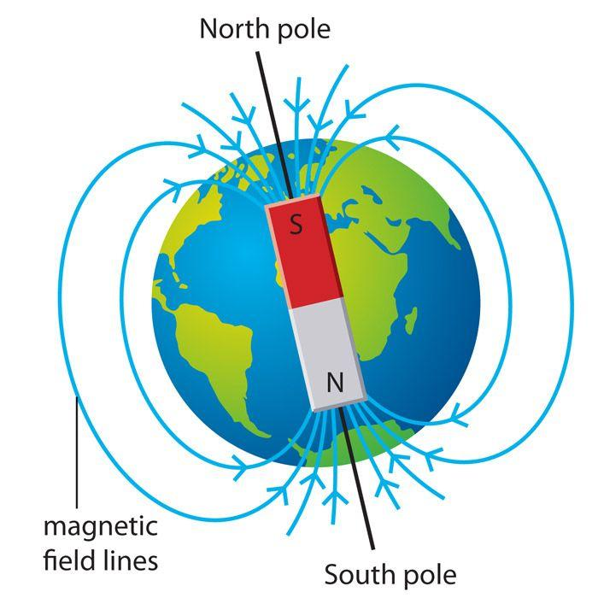
Introduction to Magnetism
Magnetism= from moving electric charges (electrons)
Every magnet has North & South poles (like repel, unlike attract)
Poles cannot be isolated
Earth is a giant magnet

Slide 3
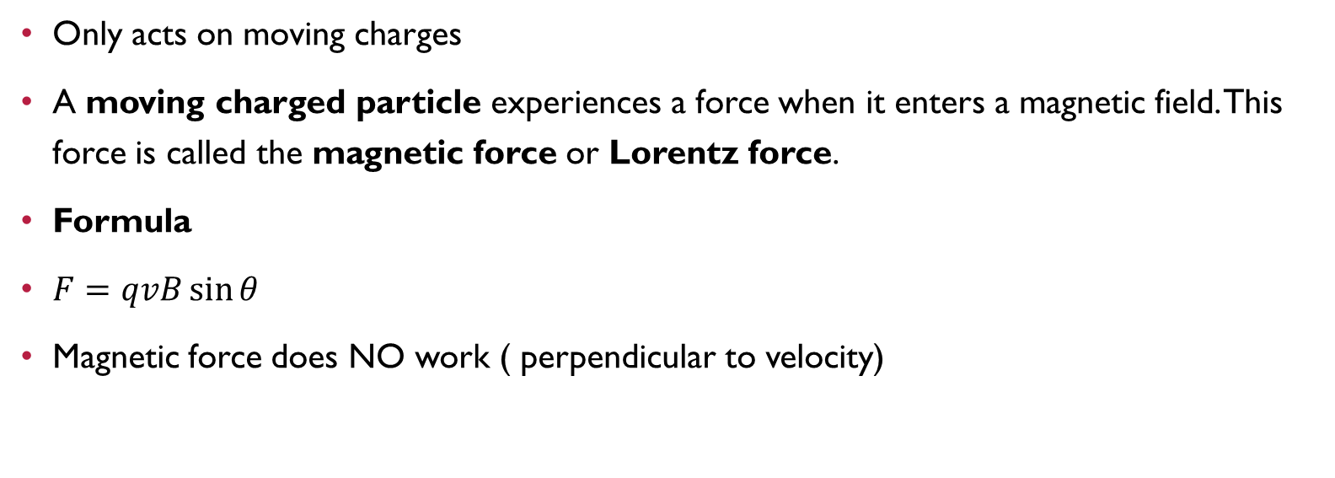
Magnetic Force on charge
Only acts on moving charges
A moving charged particle experiences a force when it enters a magnetic field. This force is called the magnetic force or Lorentz force.
Formula
$F=qvB\sin{θ}$
Magnetic force does NO work ( perpendicular to velocity)

Slide 4
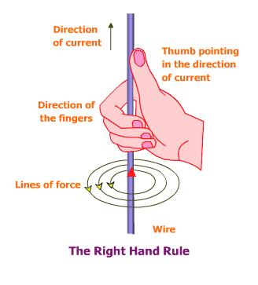

Right- Hand Rule
Direction:
Thumb = velocity (v)
Fingers curl = magnetic field (B)
Thumb = force (positive charge )
.Negative charge opposite direction
Example
A positive charge moves:
East ($v$)
In a magnetic field directed North ($B$)
Using the right-hand rule:
Fingers → East
Curl toward North
Thumb → Upward
Result: The magnetic force acts upward.

Slide 5
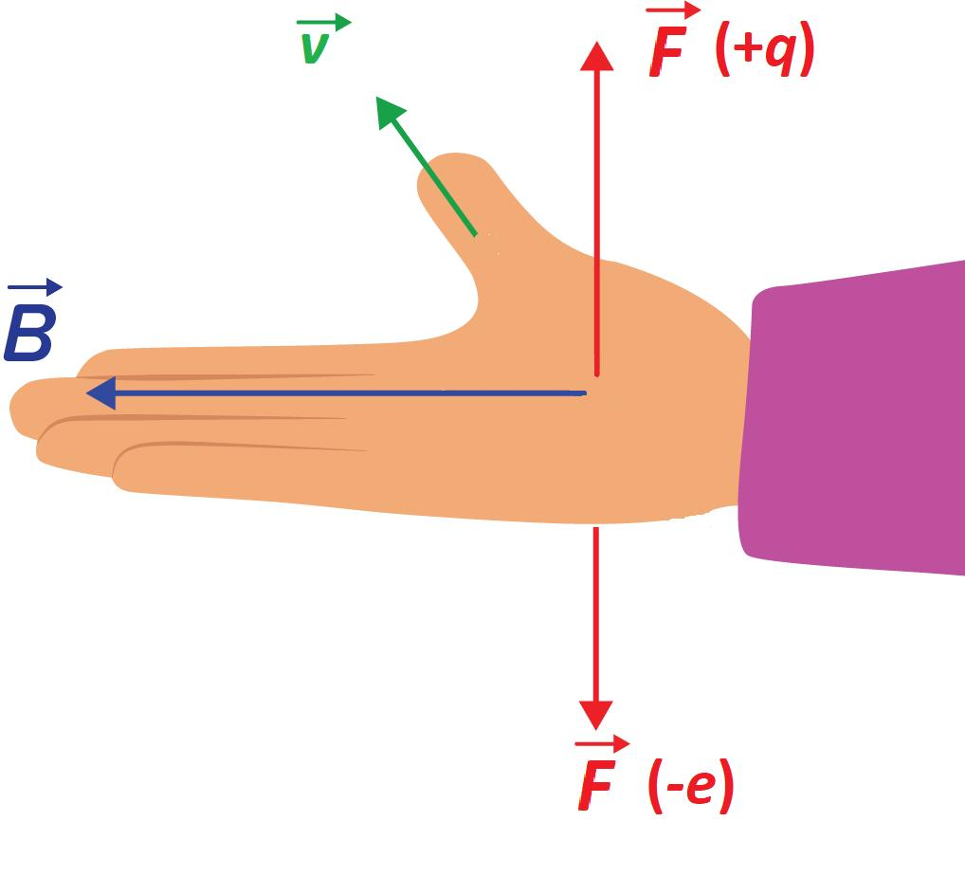
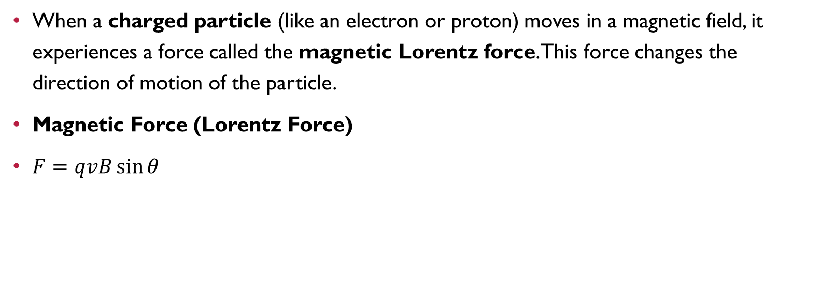
Charged Particle in B Field
When a charged particle (like an electron or proton) moves in a magnetic field, it experiences a force called the magnetic Lorentz force. This force changes the direction of motion of the particle.
Magnetic Force (Lorentz Force)
$F=qvB\sin{θ}$

Slide 6
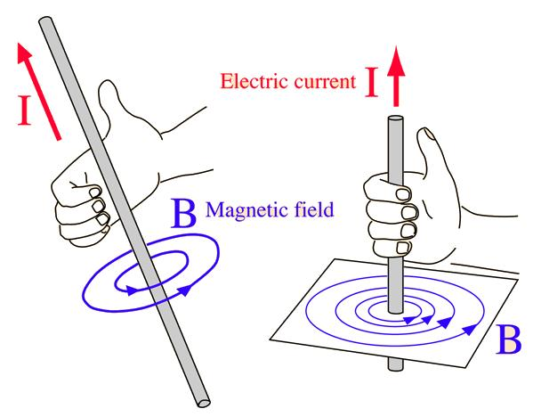
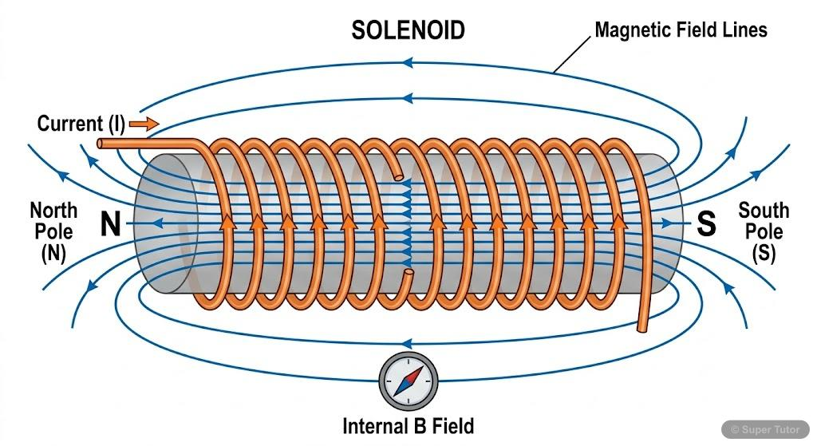
Magnetic Field from Currents
A moving electric charge creates a magnetic field. Therefore, whenever an electric current flows through a conductor, a magnetic field is produced around it.
Magnetic Field Around a Straight Wire
When current flows through a straight wire, the magnetic field forms concentric circles around the wire.
Magnetic Field Inside a Solenoid
A solenoid is a long coil of wire carrying current

Slide 7
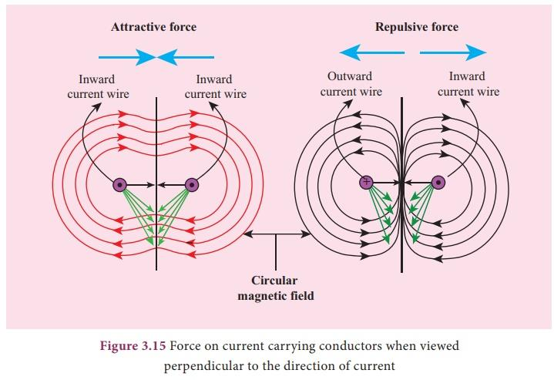

Force Between Two Currents
When two parallel wires carry electric currents, each wire creates a magnetic field that exerts a force on the other wire.
Direction of the Force
Currents in the same direction → Attract each other
Currents in opposite directions → Repel each other
Formula
The force per unit length between two long parallel wires is:
$$\frac{F}{L}=\frac{μ_{0}I_{1}I_{2}}{2πd}$$

Slide 8
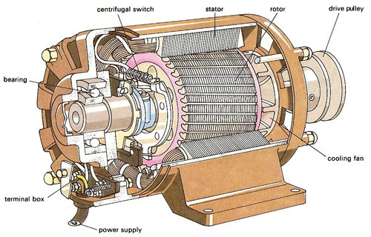
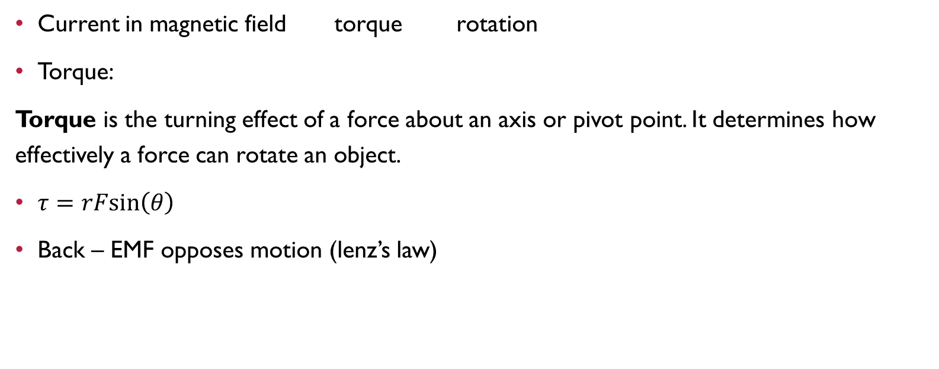
Electric Motors
Current in magnetic field torque rotation
Torque:
Torque is the turning effect of a force about an axis or pivot point. It determines how effectively a force can rotate an object.
$τ=rFsin⁡\left(θ\right)$
Back – EMF opposes motion (lenz’s law)

Slide 9
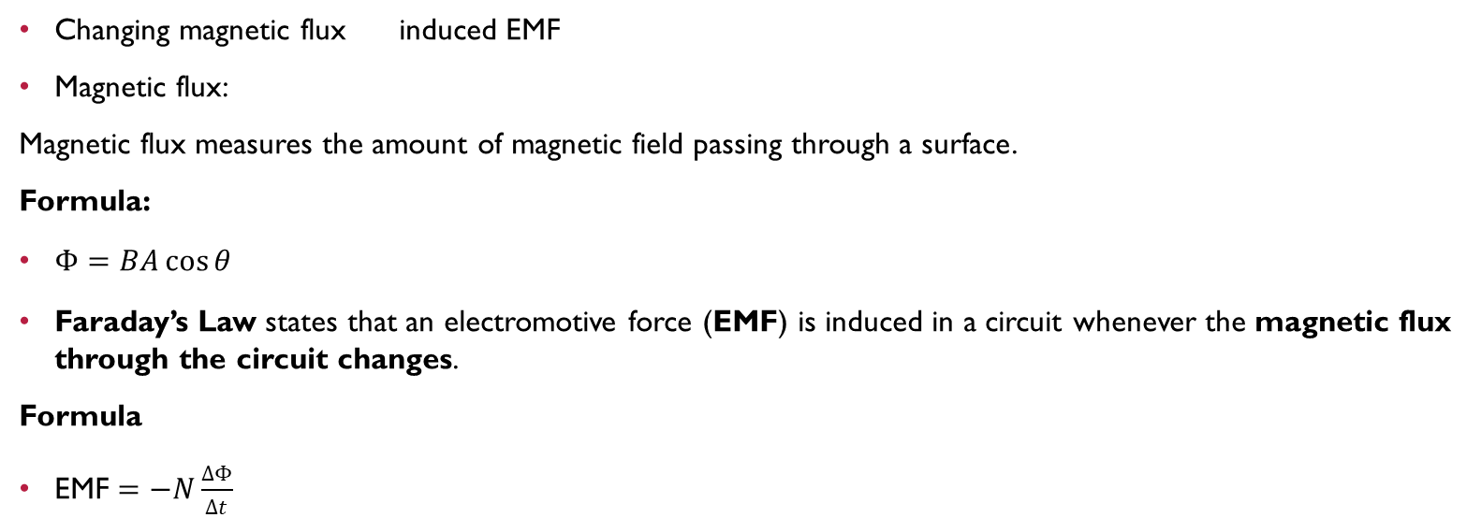
Faraday’s Law
Changing magnetic flux induced EMF
Magnetic flux:
Magnetic flux measures the amount of magnetic field passing through a surface.
Formula:
$Φ=BA\cos{θ}$
Faraday’s Law states that an electromotive force (EMF) is induced in a circuit whenever the magnetic flux through the circuit changes.
Formula
$\text{EMF}=−N\frac{ΔΦ}{Δt}$

Slide 10
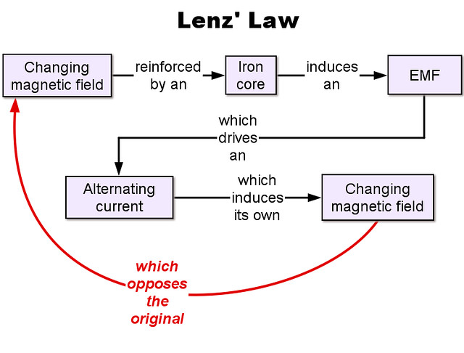
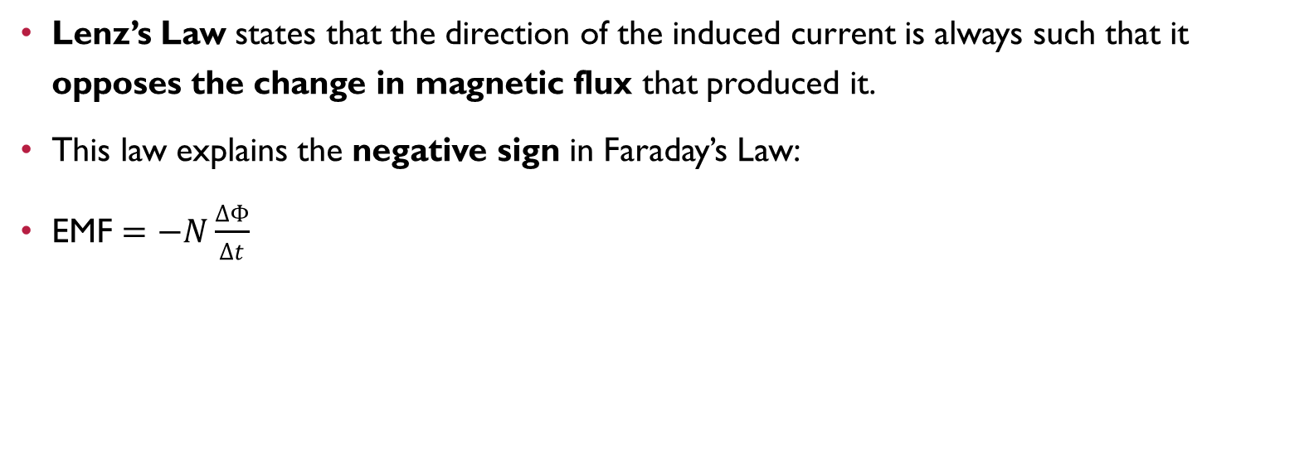
Lenz’s Law
Lenz’s Law states that the direction of the induced current is always such that it opposes the change in magnetic flux that produced it.
This law explains the negative sign in Faraday’s Law:
$\text{EMF}=−N\frac{ΔΦ}{Δt}$
This Photo by Unknown Author is licensed under CC BY-SA-NC

Slide 11
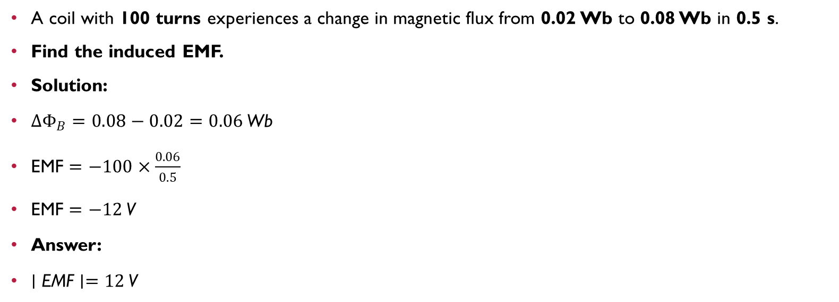
Example: Faraday’s Law
A coil with 100 turns experiences a change in magnetic flux from 0.02 Wb to 0.08 Wb in 0.5 s.
Find the induced EMF.
Solution:
$ΔΦ_{B}=0.08−0.02=0.06 \text{Wb}$
$\text{EMF}=−100×\frac{0.06}{0.5}$
$\text{EMF}=−12 \text{V}$
Answer:
$∣\text{EMF}∣=12 \text{V}$

